Slide 1

Sentiment analysis
Aditya Agrawal
Notes:
Introduce

Slide 2
Objective
To perform sentiment analysis on the collected user reviews of LendingClub and find out areas where customers face problems

Slide 3
Data
The data was scraped from two sources i.e. LendingClub and TrustPilot websites
It consists of around 10000 user reviews from verified profiles.
Columns in the dataset are Title, Content, Time and Tags.

Slide 4
Process
The data was first extracted and collected from the two sources.
It was then pre processed and this includes standardising the time format, removal of numerical characters, spelling correction, etc.
The sentiment analysis was then done for four parameters i.e. Application Process, Service, Interest Rates and Customer experience

Slide 5
Analysis on whole data

Slide 6
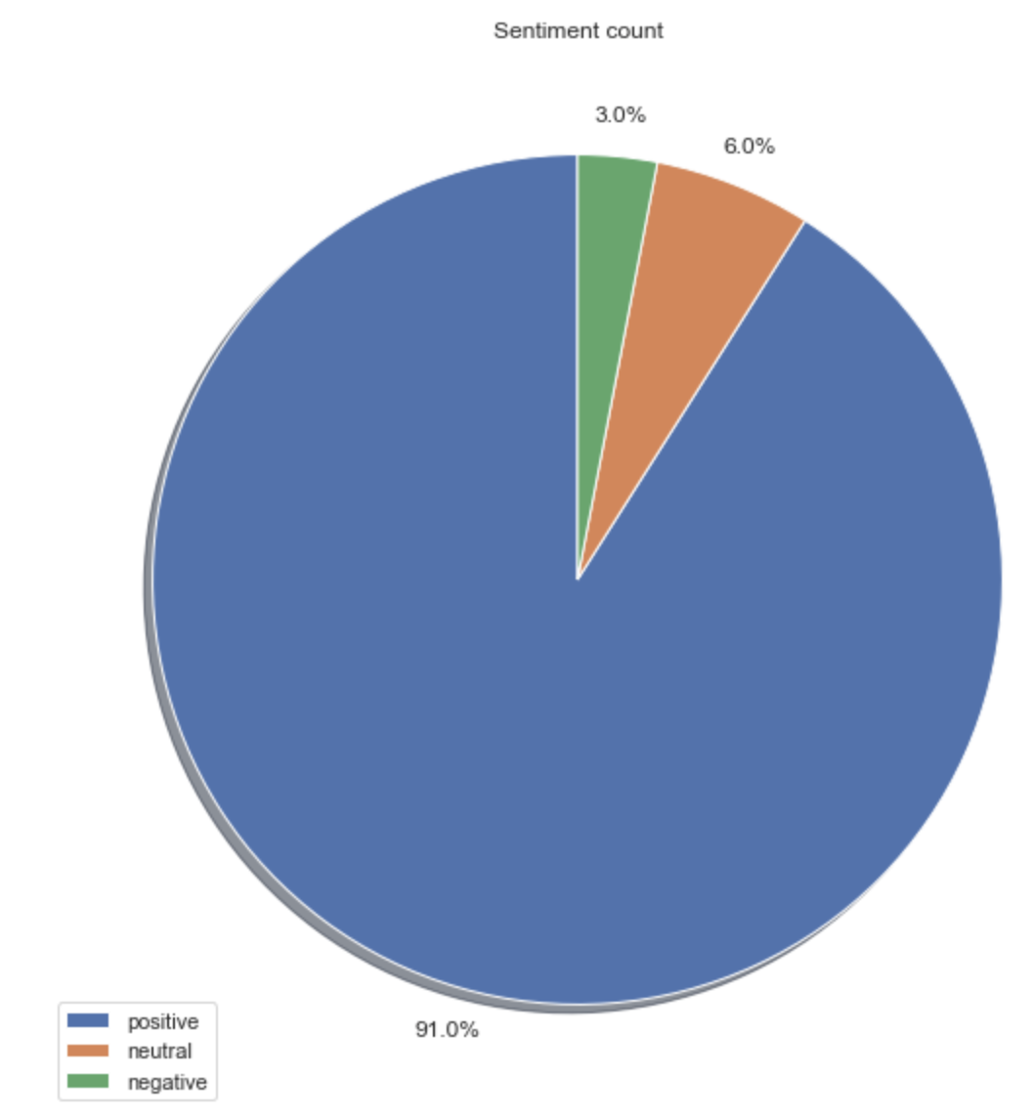
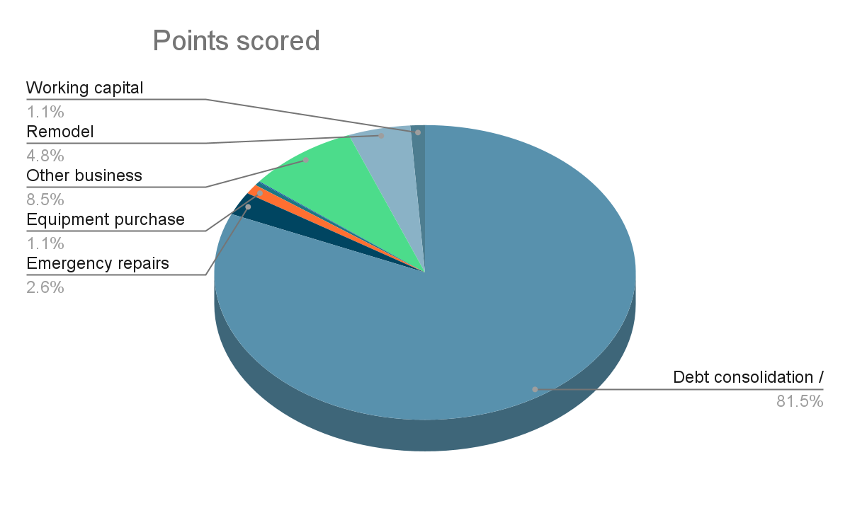
Count of Reviews

Slide 7
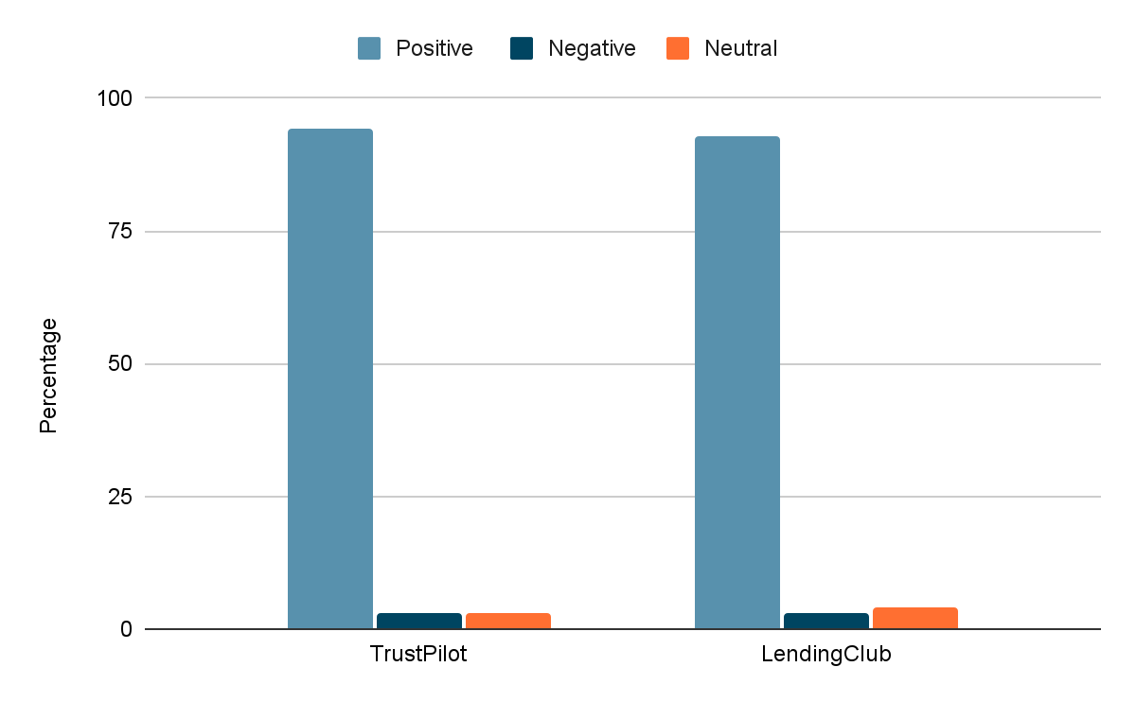
Reviews proportion from the two sources

Slide 8
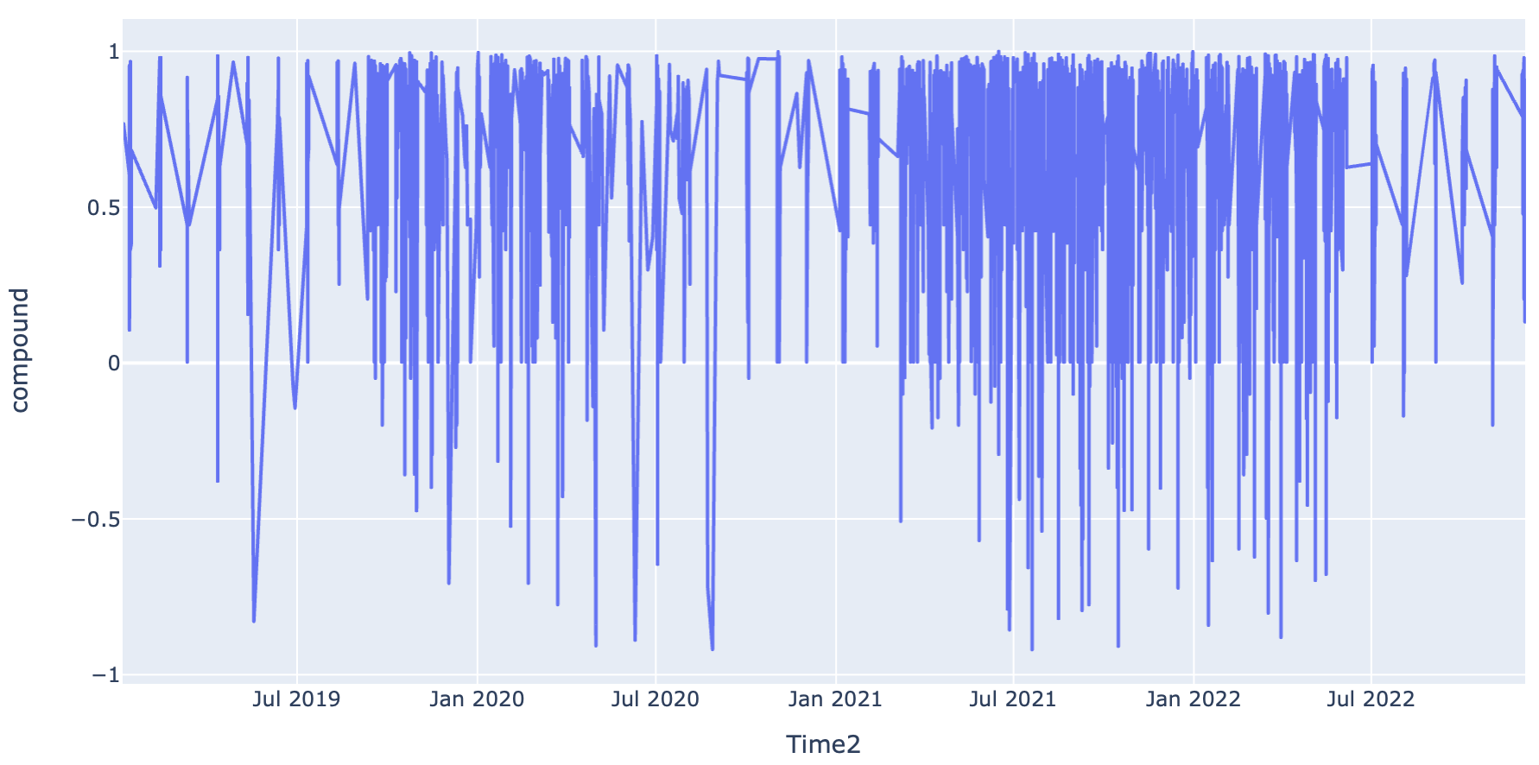
Sentiment change with time

Slide 9
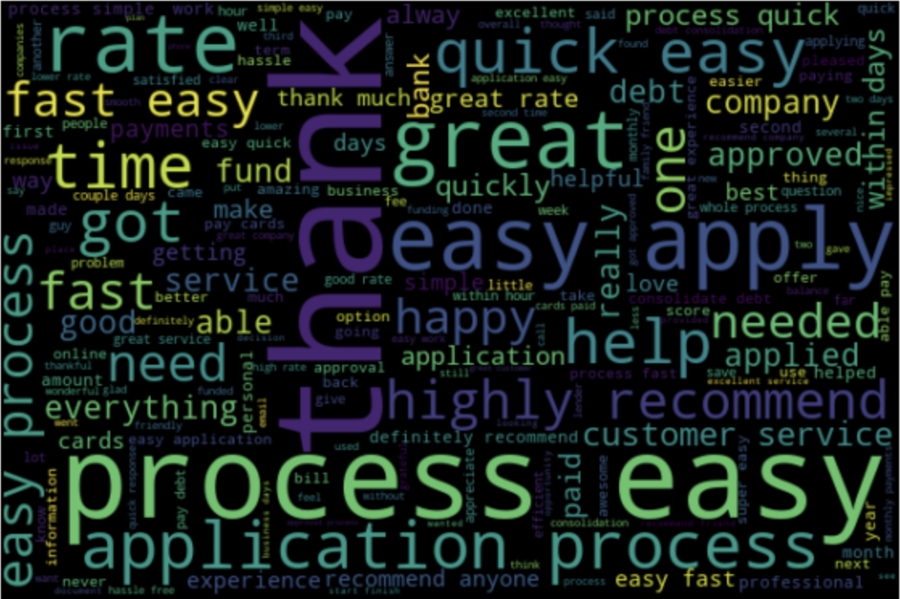
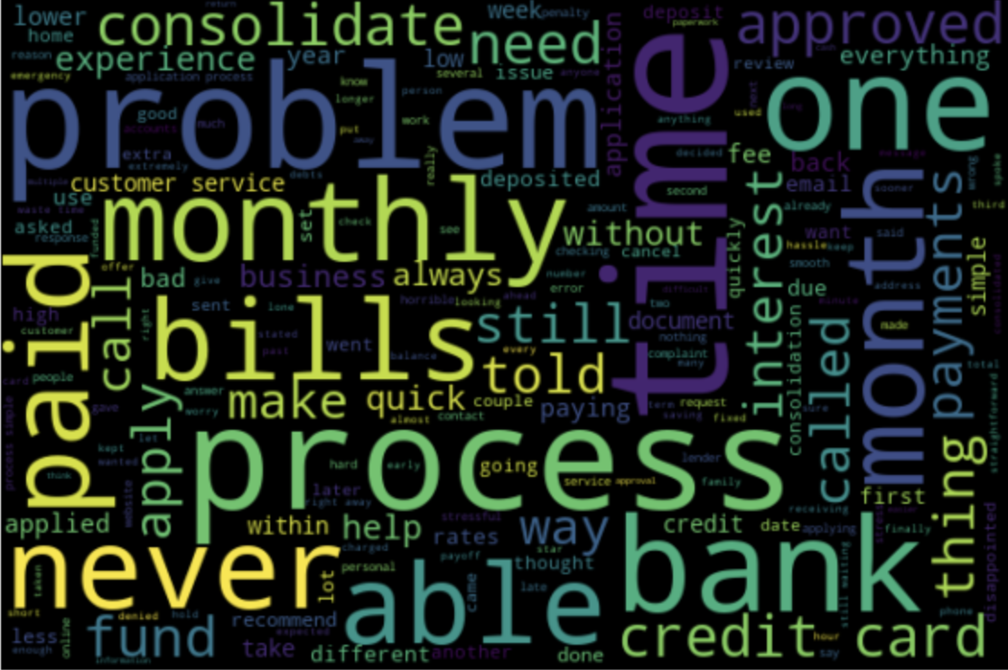
Word Clouds
Positive
Negative

Slide 10
Application Process

Slide 11
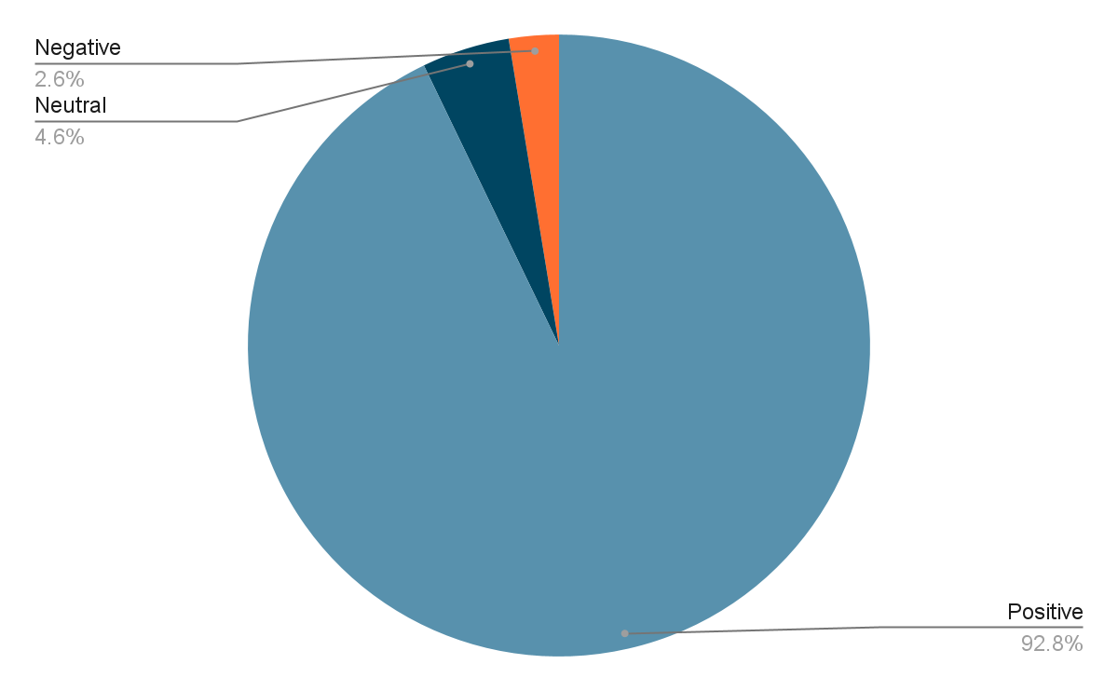
Sentiment classification count

Slide 12
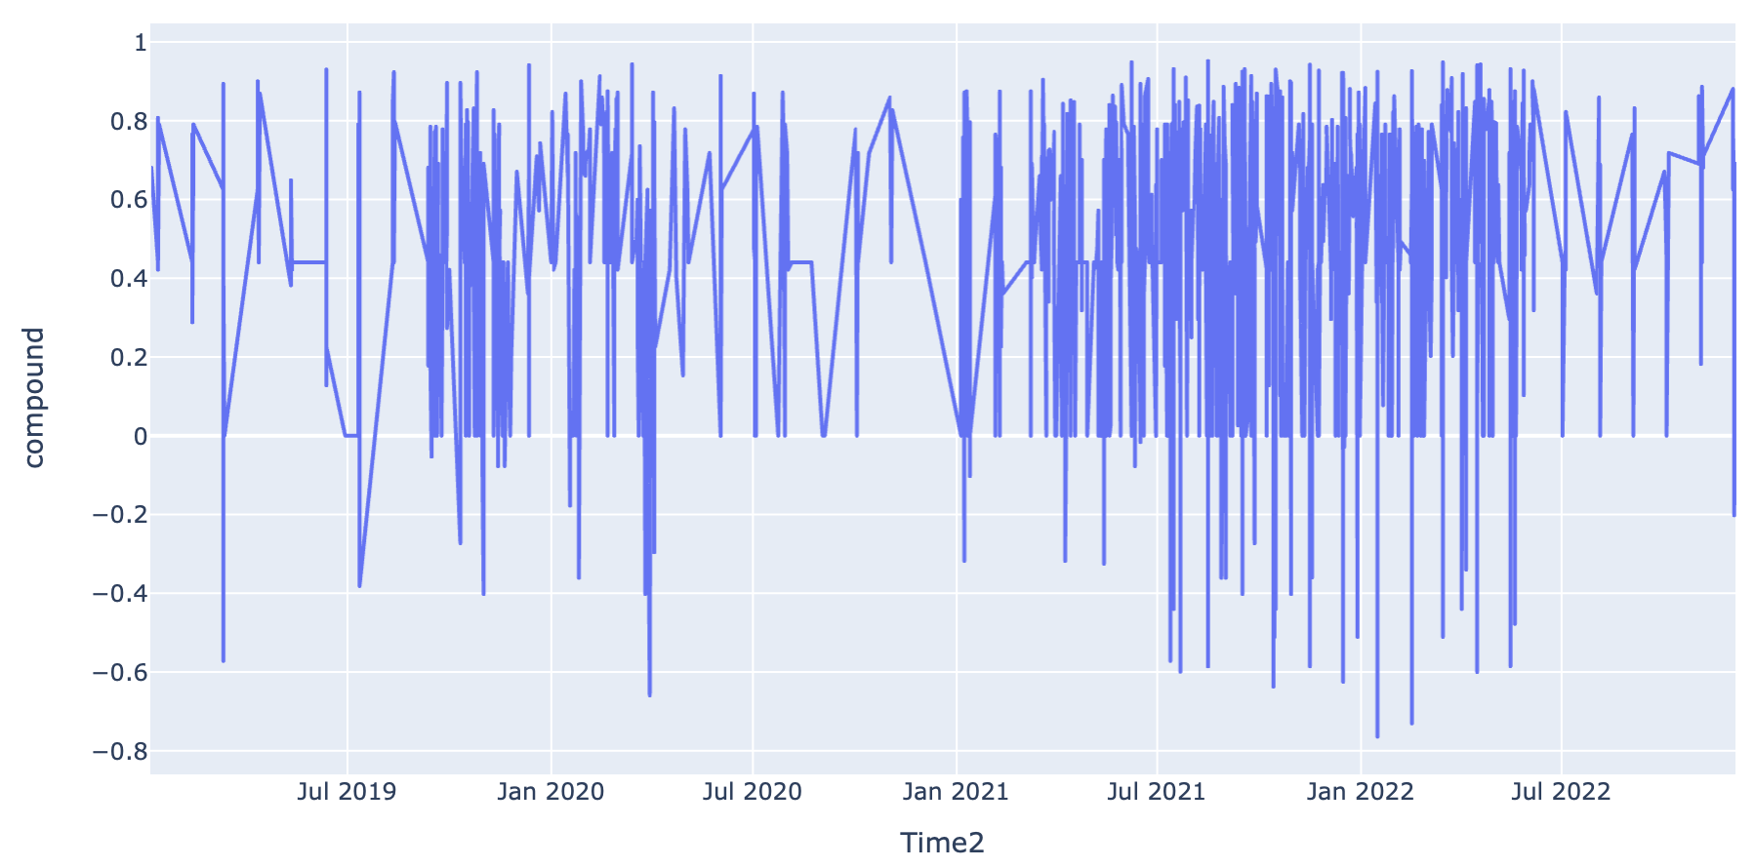
Sentiment change with time

Slide 13
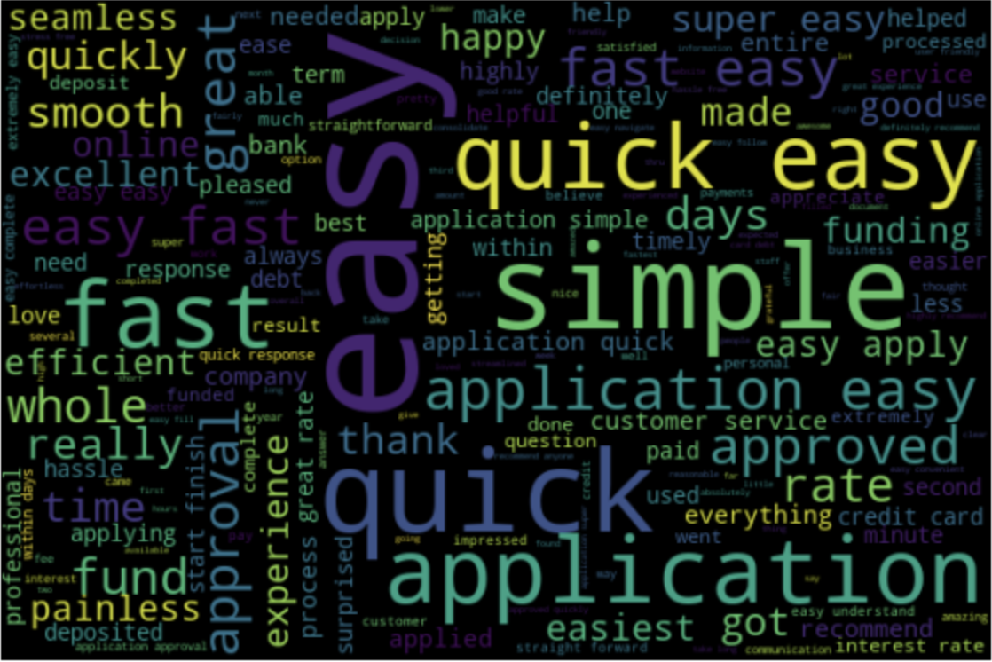
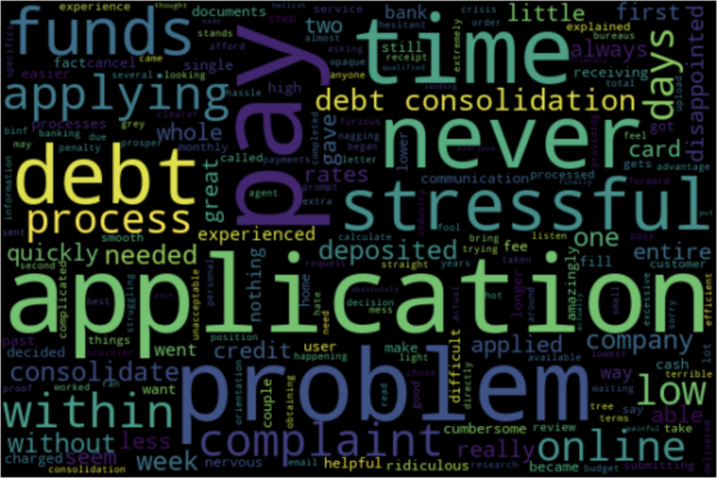
Word Clouds
Positive sentiment
Negative sentiment

Slide 14
Inferences
Some people complained about the high processing fee for the application
Few customers had issues with the long time it took for the application procedure to be completed
There is no way of knowing the status of the application and the customer did not know if the loan was approved until it was funded into bank account

Slide 15
Service

Slide 16
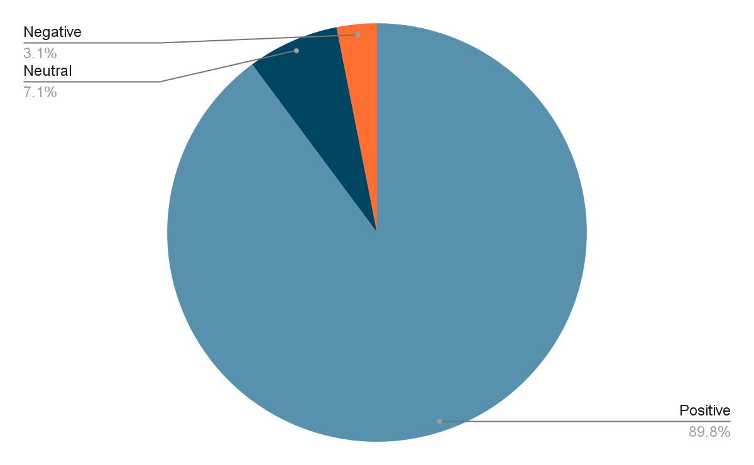
Sentiment classification count

Slide 17
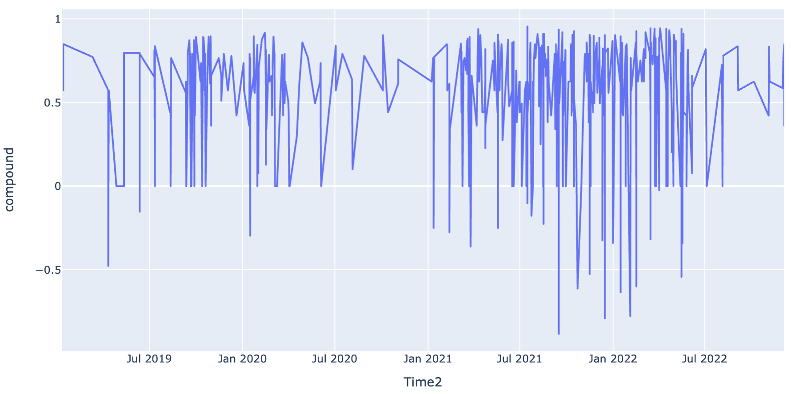
Sentiment change with time

Slide 18
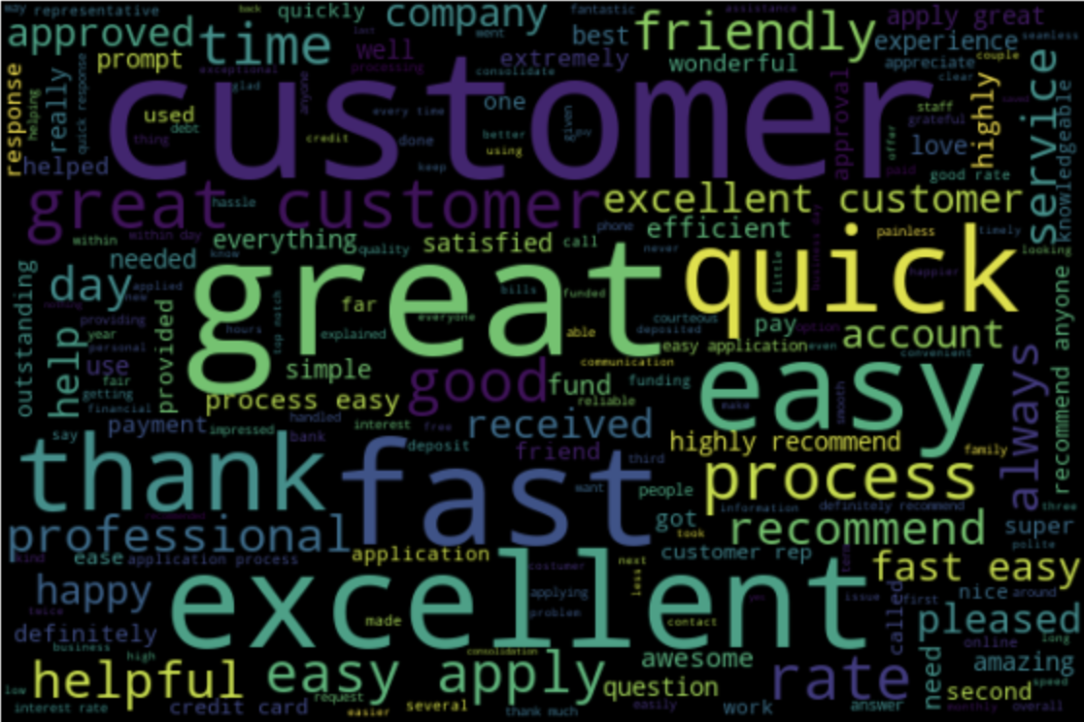
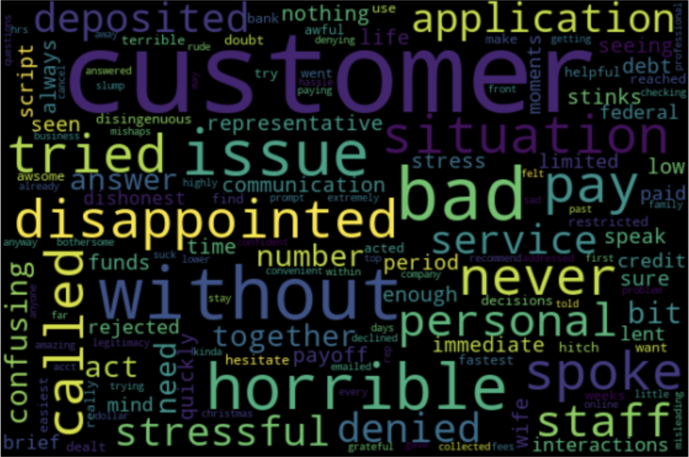
Word Clouds
Positive Sentiment
Negative Sentiment

Slide 19
Inferences
One of the most common issue was that the loan was first denied by the company but after a few days the fund was automatically transferred to their bank accounts
While most of the customers get their funds in a short time, some people said that it took a long time to get their deposit even after the loan was approved
Some people felt that there should be a number for customer service for any assistance in the process and sometimes it takes too long to get a representative on the phone

Slide 20
Interest Rates

Slide 21
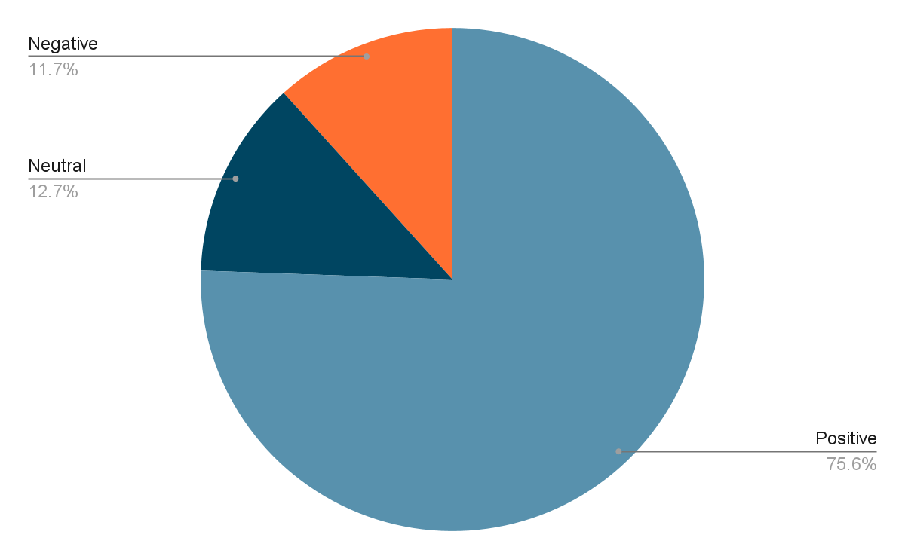
Sentiment classification count

Slide 22
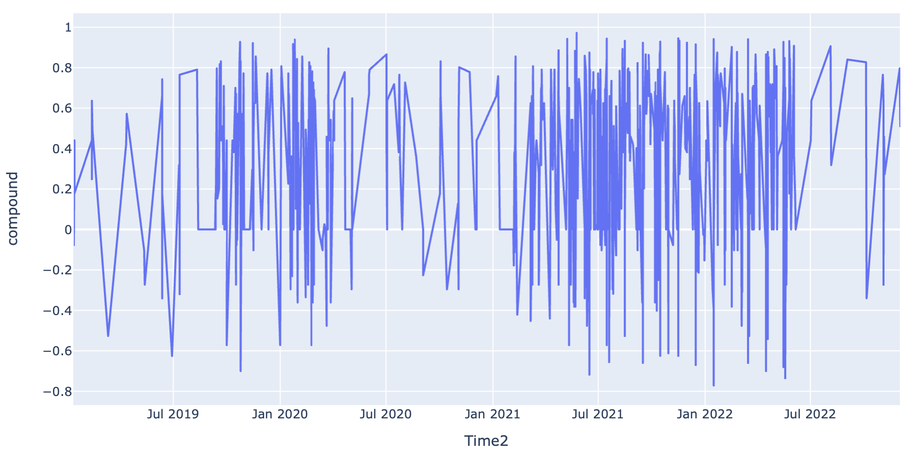
Sentiment change with time

Slide 23
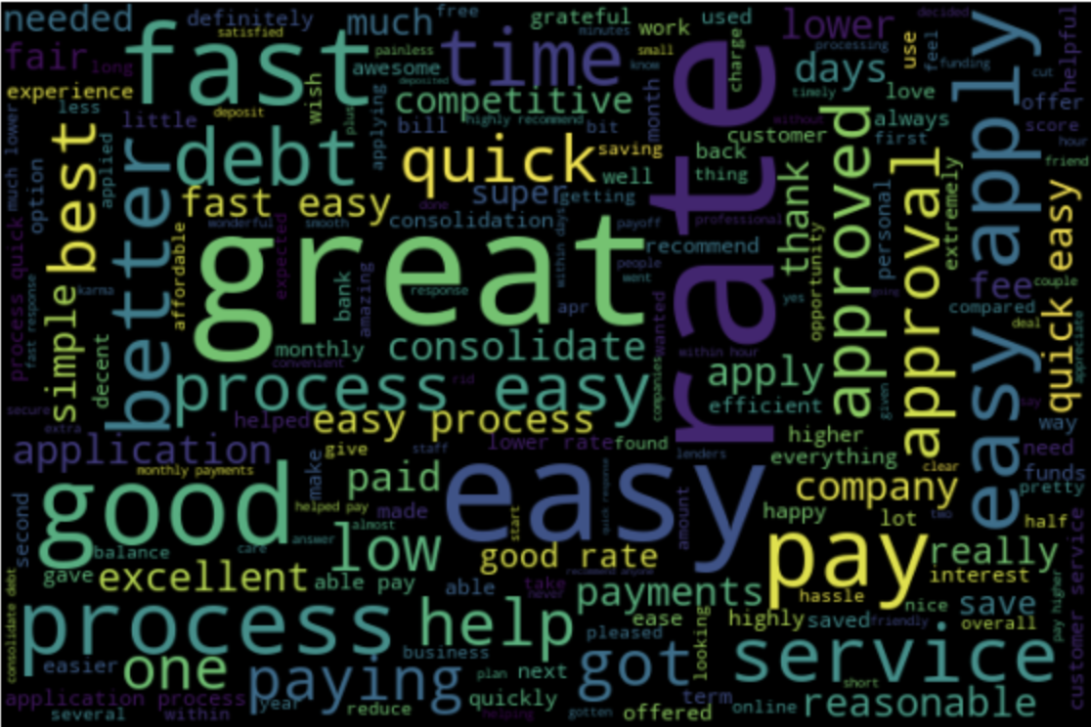
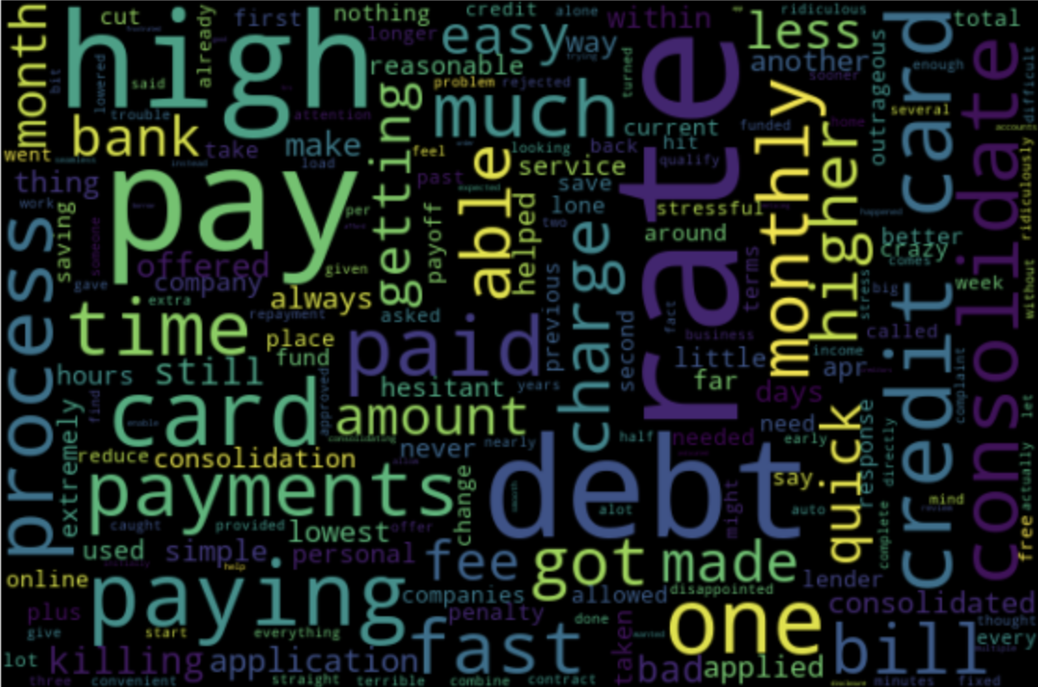
Word Clouds
Positive sentiment
Negative sentiment

Slide 24
Inferences
Some people found the interest rate high
Few customers complained that the actual rate that was charged was not what the company quoted.

Slide 25
Customer Experience

Slide 26
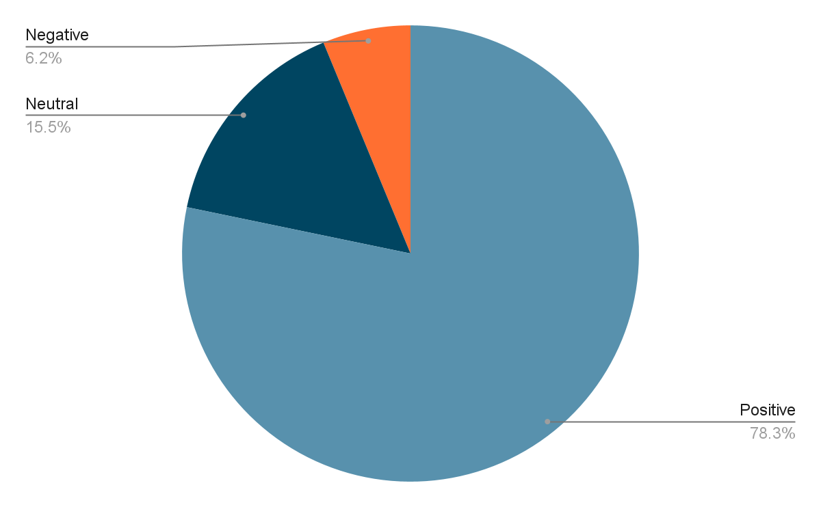
Sentiment classification count

Slide 27
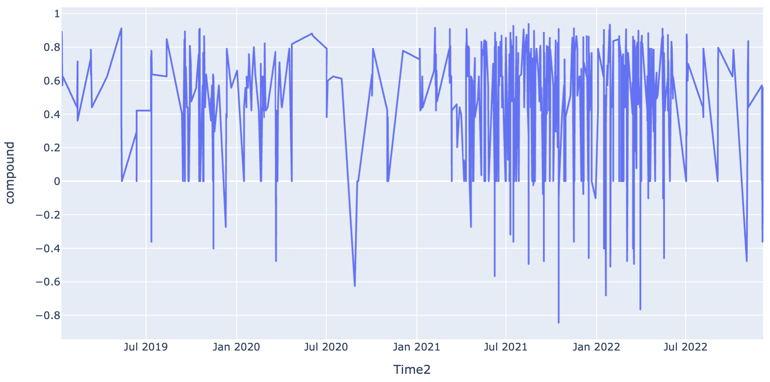
Sentiment change with time

Slide 28
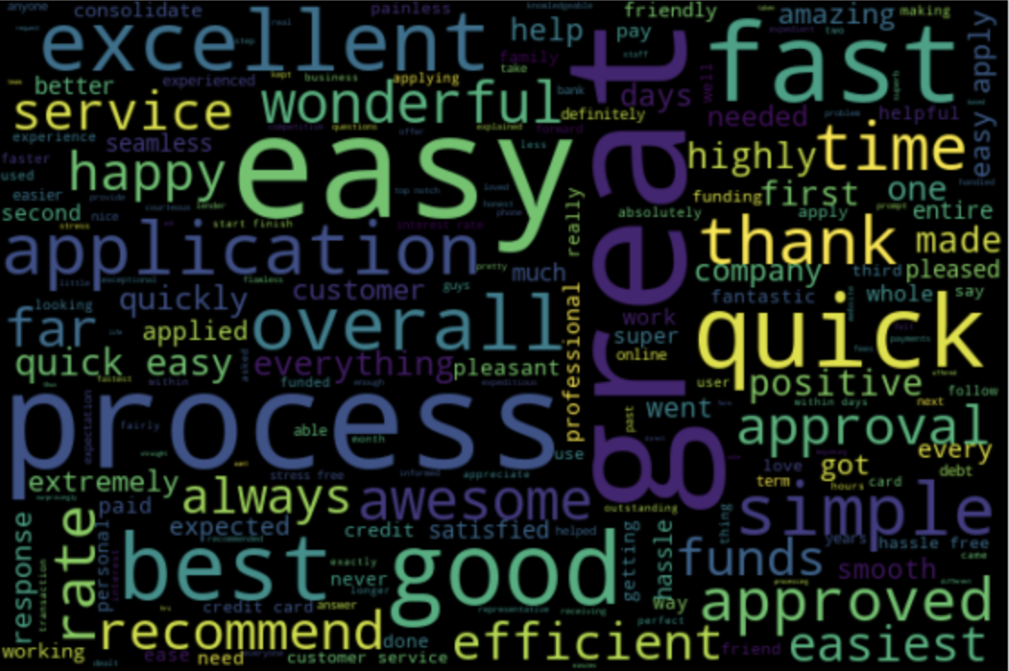
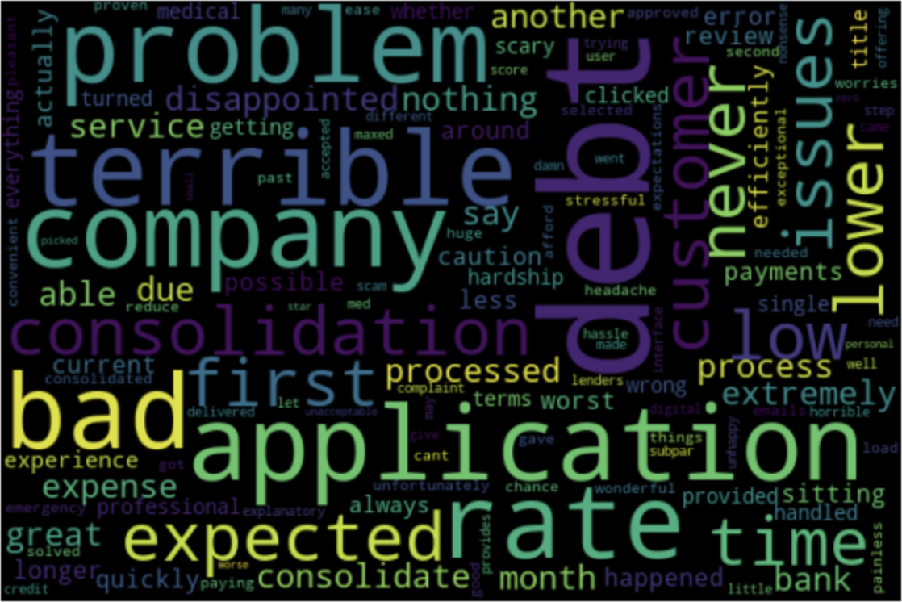
Word Clouds
Positive sentiment
Negative sentiment

Slide 29
Inferences
Submitting a website help request has proven unsuccessful
Online dashboard has lags and it has to be refreshed several times to get an up to date view
Even after unsubscribing, the spam marketing mails from the company are sent to some customers
It is hard to pay off the loan early and there is no way to add more money to your monthly payment

Slide 30
END

